Slide 1


Sandor Vas
2024-08-29

Slide 2

Outline
Executive Summary
Introduction
Methodology
Results
Conclusion
Appendix

Slide 3
Executive Summary
Summary of Methodologies
Data Collection and Wrangling:
Data Collection: Historical flight data including features like Flight Number, Date, Booster Version, Payload Mass, and Outcome.
Data Wrangling:
Cleaning: Addressed missing values and applied encoding techniques.
Scaling: Standardized features using StandardScaler.
Transformation: Converted date features to numeric formats.
Exploratory Data Analysis (EDA):
Visual Analytics: Utilized tools like Matplotlib, Seaborn, and Plotly for effective data visualization.
Interactive Maps/Dashboards: Developed using Folium and Plotly Dash for geographic and interactive analysis.
Predictive Modeling:
Model Selection: Employed models including Logistic Regression, Support Vector Machines (SVM), Decision Tree Classifier, and K-Nearest Neighbors (KNN).
Hyperparameter Tuning: Optimized model parameters using GridSearchCV.
Model Evaluation: Assessed model performance through cross-validation and accuracy metrics.

Slide 4
Introduction
Project Background and Context
Background:
Space missions are complex operations with various factors influencing their success.
Historical data from space missions provides valuable insights into these factors and helps in predicting the outcomes of future missions.
This project leverages historical flight data to understand and predict the success of space missions.
Context:
The dataset includes records of past space missions with features such as flight number, date, booster version, payload mass, and mission outcome.
Analyzing this data allows us to identify patterns and factors that contribute to the success or failure of missions.
Problems to Address
Data Challenges:
Missing Values: How to handle incomplete data and ensure data integrity.
Categorical Data: How to encode non-numeric features (e.g., booster version, outcome).
Feature Scaling: How to standardize numerical features for model training.
Exploratory Data Analysis (EDA):
Patterns and Trends: What trends or patterns are visible in the data? How do different features relate to the mission outcome?
Visualizations: How can visualizations help in understanding the data better?
Predictive Modeling:
Model Selection: Which machine learning models (e.g., Logistic Regression, SVM, Decision Tree, KNN) are best suited for predicting mission success?
Hyperparameter Tuning: How can we optimize model parameters for better performance?
Evaluation Metrics: What metrics should be used to evaluate the performance of predictive models?

Slide 5

Section 1

Slide 6
Methodology
1. Data Collection and Wrangling
Data Collection:
Source: Historical flight data including features such as Flight Number, Date, Booster Version, Payload Mass, and Outcome.
Format: CSV files.
Data Wrangling:
Cleaning: Handling missing values, correcting data inconsistencies, and filtering out irrelevant records.
Encoding: Converting categorical variables (e.g., Booster Version, Outcome) into numeric formats using techniques such as one-hot encoding.
Feature Scaling: Standardizing numerical features using StandardScaler to ensure uniformity in model training.
Transformation: Converting date features into numerical values for analysis.
2. Exploratory Data Analysis (EDA)
Visual Analytics:
Tools Used: Matplotlib, Seaborn, Plotly.
Techniques: Generating visualizations such as histograms, scatter plots, and heatmaps to uncover patterns and trends.
Interactive Maps and Dashboards:
Tools Used: Folium for interactive maps, Plotly Dash for interactive dashboards.
Purpose: To provide interactive and insightful visual representations of data.

Slide 7
Methodology (continued)
3. Predictive Modeling
Model Selection:
Algorithms Used: Logistic Regression, Support Vector Machine (SVM), Decision Tree Classifier, K-Nearest Neighbors (KNN).
Hyperparameter Tuning:
Technique: GridSearchCV for finding the best hyperparameters for each model.
Parameters Optimized: Specific to each algorithm (e.g., regularization strength for Logistic Regression, kernel type for SVM).
Model Evaluation:
Method: Cross-validation to assess model performance and avoid overfitting.
Metrics Used: Accuracy, confusion matrix, and other relevant evaluation metrics to determine model effectiveness.
4. Tools and Libraries
Programming Languages: Python.
Libraries: pandas, numpy, scikit-learn, matplotlib, seaborn, plotly, folium.

Slide 8
Data Collection
Source Identification
Data Extraction
Data Acquisition
Initial Data Inspection
Preliminary Data Handling
Historical Flight Data
Data Format: CSV
Download CSV files
Extract relevant columns: Flight Number, Date, Booster Version, Payload Mass, Outcome
Source Method: Public Repository / Internal Database / API
Check Structure: Verify data completeness
Identify Issues: Missing values, inconsistencies
Load Data: Into analysis tools
Initial Cleaning: Handle missing values, check data types

Slide 9
Data Collection – SpaceX API
There are four python functions defined to support the data collection from the following end points:
https://api.spacexdata.com/v4/rockets/
https://api.spacexdata.com/v4/launchpads
https://api.spacexdata.com/v4/payloads
https://api.spacexdata.com/v4/cores/
Function Overview:
getBoosterVersion(data):
Purpose: Extracts names of rocket boosters from the data.
Process: Iterates through the rocket information, fetches details, and stores booster names.
getLaunchSite(data):
Purpose: Extracts details about launch sites.
Process: Iterates through launch pad information, fetches details, and stores location and name.
getPayloadData(data):
Purpose: Extracts information about payloads.
Process: Iterates through payload information, fetches details, and stores mass and orbit data.
getCoreData(data):
Purpose: Extracts details about rocket cores.
Process: Iterates through core information, fetches details, and stores various attributes such as block number and reuse count.
GitHub URL
https://github.com/sandorvas/applied-data-science-capstone/blob/main/jupyter-labs-spacex-data-collection-api.ipynb
request.get call with a static json url
Normalize json data (came with the response) and create a pandas data frame
API again to get information about the launches using the IDs given for each launch. using columns rocket, payloads, launchpad, and cores
Call getBoosterVersion
Call getLaunchSite
Call getPayloadData
Call getCoreData
Construct the lauch_dict dictionary
Create a launch_data dataframe from launch_dict

Slide 10
Data Collection - Scraping
Web scraping Falcon 9 and Falcon Heavy Launches Records from Wikipedia
List of Falcon 9 and Falcon Heavy launches Wikipage updated on 9th June 2021
Web scrap Falcon 9 launch records with BeautifulSoup:
Extract a Falcon 9 launch records HTML table from Wikipedia
Parse the table and convert it into a Pandas dataframe
Process web scraped HTML table with some predefined helper functions
perform an HTTP GET method to request the Falcon9 Launch HTML page, as an HTTP response.
find all tables on the wiki page
Iterate through the <th> elements and apply the provided extract_column_from_header()
Create a data frame by parsing the launch HTML tables
Create the dataframe based on the completed launch_ dict dictionary
Save the dataframe to spacex_web_scraped.csv
use requests.get() method with the provided static_url to get resconse object
Create a BeautifulSoup object from the response text content
find_all function in the BeautifulSoup object, with element type `table` and assign to a list called html_tables
List of Falcon 9 and Falcon Heavy launches Wikipage updated on 9th June 2021
extract columns from the header, construct the launch dictionary (launh_dict) from keys and extract each tables
Create dataframe from the filled and parsed launch_dict and save the dataframe to the space_web_scraped.csv file

Slide 11
Data Wrangling
Data wrangling was performed to clean, transform, and prepare the raw data for analysis. This ensured the data was accurate, complete, and suitable for modeling.
Data Cleaning:
Handling Missing Values: Missing values were handled by imputation with mean values for numerical features and mode values for categorical features.
Removing Duplicates: Duplicate records were identified and removed to maintain data quality.
Correcting Errors: Errors such as incorrect data types were corrected, and outliers were addressed through filtering.
Feature Engineering:
Creating New Features: Extracted the year from date columns and created logarithmic transformations for mass.
Encoding Categorical Variables: Converted categorical variables into numerical values using one-hot encoding.
Scaling Features: Standardized numerical features to ensure they were on a common scale.
Data Transformation:
Data Aggregation: Aggregated data by summing values to create summary statistics.
Date/Time Transformation: Transformed date/time features into numerical components.
Create dataframe from the csv file
Evaluate the dataset for missing data
Identify and calculate the percentage of the missing values in each attribute and Identify which columns are numerical and categorical
Calculate the number of launches on each site and the number and occurrence of mission outcome of the orbits
Calculate the number of launches on each site and the number and occurrence of mission outcome of the orbits
Create s landing outcome label from outcome column

Slide 12
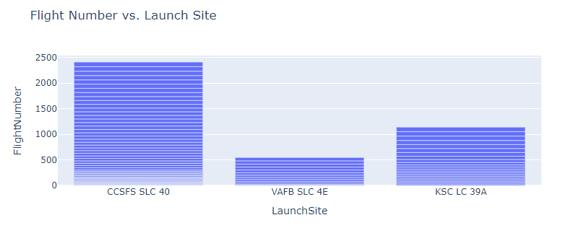
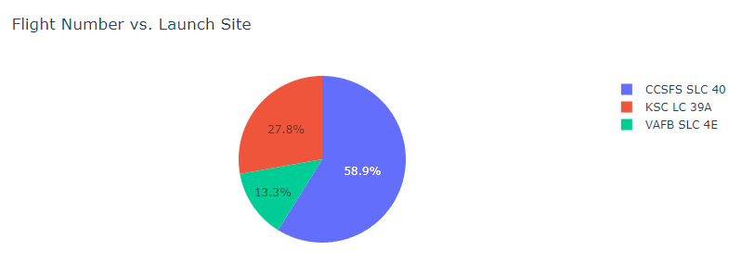
EDA with Data Visualization (1)
1. Flight Number vs. Launch Site
Chart Type: Bar Chart and pie chart
Purpose:
To visualize the frequency of launches per launch site
This helps identify which launch sites are most frequently used
and how the number of launches varies by site.

Slide 13
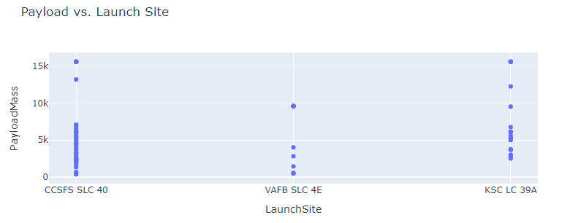
EDA with Data Visualization (2)
2. Payload vs. Launch Site
Chart Type: Scatter Plot
Purpose:
To analyze the relationship between payload mass and launch site.
This helps in understanding if there is any correlation between the
payload mass and the launch site used.

Slide 14
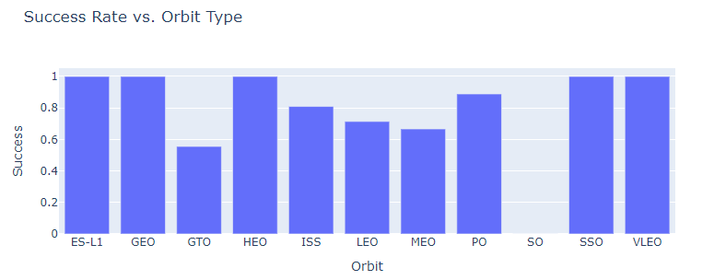
EDA with Data Visualization (3)
3. Success Rate vs. Orbit Type
Chart Type: Bar Chart
Purpose:
To show the success rate of launches for each orbit type.
This allows you to evaluate which orbits are associated with
higher or lower success rates.

Slide 15
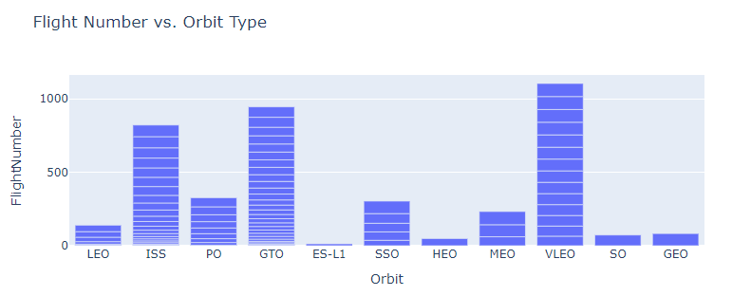
EDA with Data Visualization (4)
4. Flight Number vs. Orbit Type
Chart Type: Bar Chart
Purpose:
To see how the number of flights varies across different orbit types.
This helps in understanding the distribution of different orbits used over time.

Slide 16
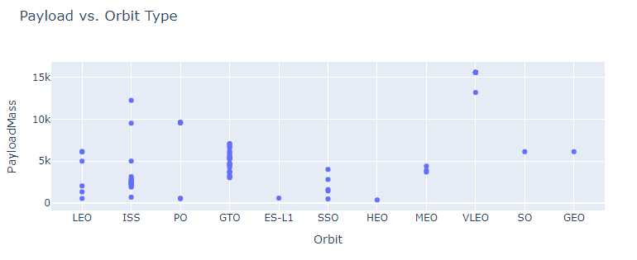
EDA with Data Visualization (5)
5. Payload vs. Orbit Type
Chart Type: Scatter Plot
Purpose:
To explore how payload masses are distributed across different orbit types.
This can reveal trends or outliers in payload sizes based on the orbit type.
.

Slide 17
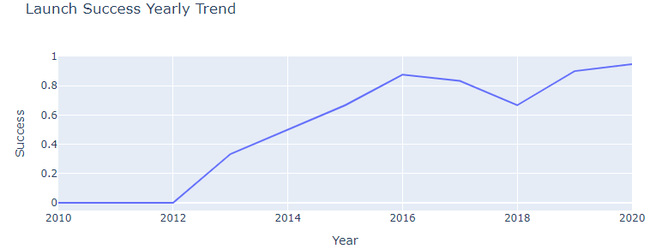
EDA with Data Visualization (6)
6. Launch Success Yearly Trend
Chart Type: Line Chart
Purpose:
To track the trend of successful launches over the years.
This helps in visualizing how the success rate of launches has evolved over time.
.
.

Slide 18
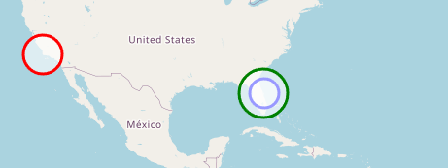
Build an Interactive Map with Folium
1. Markers:
What: Used folium.Marker with a DivIcon to add labels at specific launch site locations.
Why: Markers help identify the exact location of each launch site on the map. The DivIcon allows custom labels to provide clear information about the site’s name, making it easier for users to recognize and differentiate between the launch sites.
2. Circles:
What: Used folium.Circle to add circular areas around each launch site.
Why: Circles are used to visually emphasize the area around each launch site. By adjusting the radius and color, these circles provide a clear visual representation of the proximity around each site. The white fill with colored borders ensures that the circles are visible against various map backgrounds without obscuring other details.

Slide 19
Predictive Analysis (Classification)
1. Building the Classification Model:
1.1. Data Preparation:
Data Loading: Read and preprocess the data from CSV files.
Feature Engineering: Encode categorical variables, scale features, and split data into training and testing sets.
1.2. Model Selection:
Models Chosen: Support Vector Machine (SVM), Classification Trees, and Logistic Regression.
Initial Training: Train each model using the training data.
1.3. Hyperparameter Tuning:
Grid Search: Perform hyperparameter tuning for each model to find the optimal parameters.
Cross-Validation: Use cross-validation to ensure robustness and prevent overfitting.
2. Evaluating the Models:
2.1. Performance Metrics:
Accuracy: Measure the overall correctness of the model.
Confusion Matrix: Analyze the true positives, false positives, true negatives, and false negatives.
ROC Curve & AUC: Evaluate the model’s ability to discriminate between classes.
2.2. Model Comparison:
Compare Metrics: Evaluate and compare the performance metrics of different models.
Select Best Model: Determine the best-performing model based on evaluation metrics.
3. Improving the Models:
3.1. Feature Selection:
Refine Features: Identify and include relevant features to improve model performance.
Remove Noise: Eliminate irrelevant or redundant features.
3.2. Model Tuning:
Adjust Parameters: Fine-tune hyperparameters based on evaluation results.
Re-train Models: Retrain models with updated parameters.
4. Finding the Best Performing Model:
4.1. Final Evaluation:
Re-evaluate Models: Assess the improved models using the same performance metrics.
Choose the Best Model: Select the model with the highest accuracy, best ROC AUC score, and other relevant metrics.

Slide 20
Build a Dashboard with Plotly Dash
Setup:
Import Libraries: Begin by importing necessary libraries like dash, dash_core_components, dash_html_components, and plotly.graph_objs.
Initialize App: Create an instance of the Dash app using dash.Dash().
Layout:
Define Layout: Set up the layout of the dashboard using html.Div() to organize components such as dropdowns, graphs, and buttons.
Add Components:
Dropdown Menus: Include dcc.Dropdown() for selecting different categories or filters. This allows users to choose specific data points or categories to view.
Graphs and Plots: Add dcc.Graph() components to display plots such as scatter plots, bar charts, and line charts.
Other Interactions: Implement additional components like dcc.Slider() or dcc.Checklist() based on requirements.
2. Interactive Elements
Callbacks:
Define Callbacks: Use @app.callback to create functions that update components based on user interactions. For example, a callback function might update a graph based on the selected value from a dropdown menu.
Input and Output: Specify which components are inputs (e.g., dropdown selections) and which are outputs (e.g., updated graphs).
Real-Time Updates:
Dynamic Updates: Ensure that user selections trigger real-time updates to the dashboard. This might involve filtering data, changing plot types, or updating information displayed on the dashboard.

Slide 21
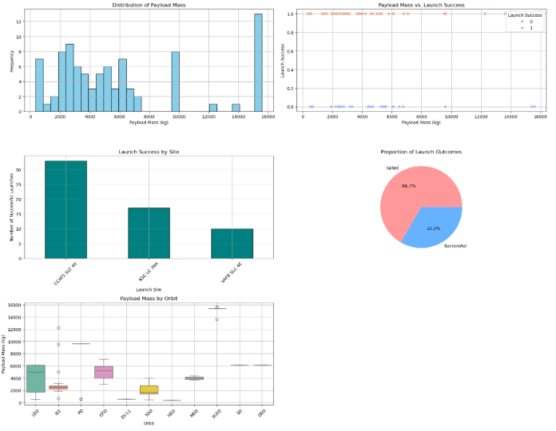
Results (1)
Explanation:
Histogram of Payload Mass: Shows the distribution of payload mass, indicating how frequently payloads of various sizes are launched.
Scatter Plot of Payload Mass vs. Launch Success: Displays the relationship between payload mass and launch success, helping to visualize if payload mass affects the outcome.
Bar Chart of Launch Success by Site: Provides insight into which launch sites have more successful launches, helping to compare performance across sites.
Pie Chart of Launch Outcomes: Shows the proportion of successful versus failed launches, giving an overall success rate.
Box Plot of Payload Mass by Orbit: Illustrates the distribution of payload mass for different orbits, helping to understand payload variations across different orbital missions.

Slide 22
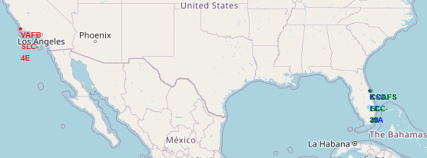
Results (2)
Interactive Map with Launch Sites: Helps in understanding the geographical distribution and proximity of launch sites.
Color-Coded Outcomes: Indicates the success/failure of launches directly on the map.
Proximity Map: Shows the closeness of launch sites to significant features like railways and highways, which can impact logistics and accessibility.

Slide 23

Section 2

Slide 24
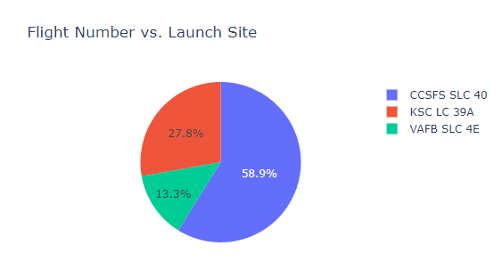
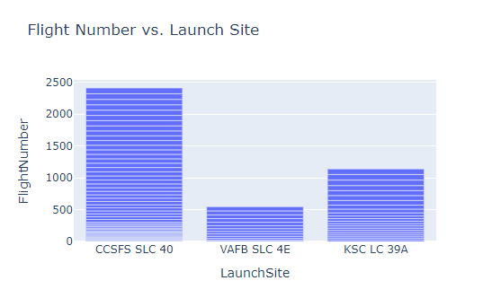
Flight Number vs. Launch Site
Explanation:
This bar chart shows the count of flights (FlightNumber) for each launch site (LaunchSite).
The height of each bar represents the number of flights at that site.

Slide 25
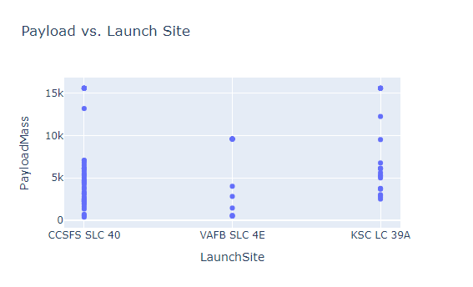
Payload vs. Launch Site
Explanation:
This scatter plot displays the payload mass (PayloadMass) for each launch site
(LaunchSite). Each point represents a launch and its payload mass.

Slide 26
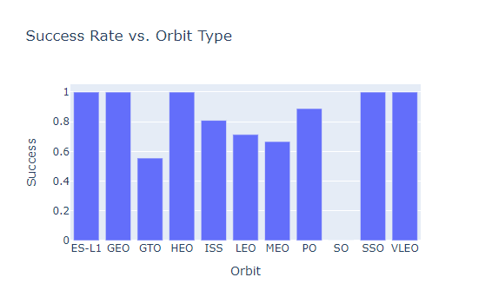
Success Rate vs. Orbit Type
Objective: Show the average success rate for each orbit type.
Explanation
This bar chart shows the average success rate (Success) for each orbit type (Orbit). The success rate is calculated as the mean of success indicators (0 or 1) for each orbit type.

Slide 27
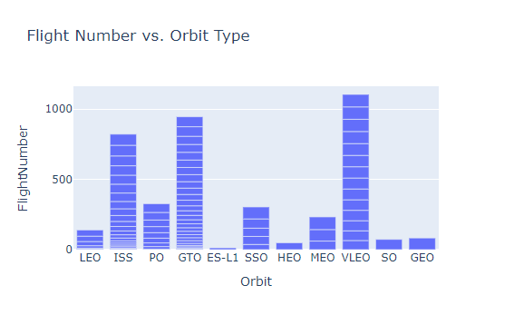
Flight Number vs. Orbit Type
Objective: Show the relationship between payload mass and orbit type.
Explanation
This bar chart shows the count of flights (FlightNumber) for each orbit type (Orbit). The height of each bar represents the number of flights for that orbit type.

Slide 28
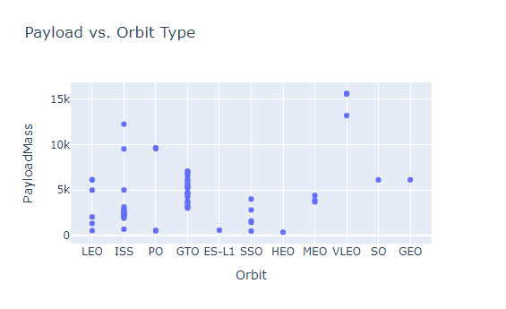
Payload vs. Orbit Type
Objective: Show the relationship between payload mass and orbit type
Explanation
This scatter plot displays payload mass (PayloadMass) against orbit type (Orbit). Each point represents a launch with its payload mass and corresponding orbit type.

Slide 29
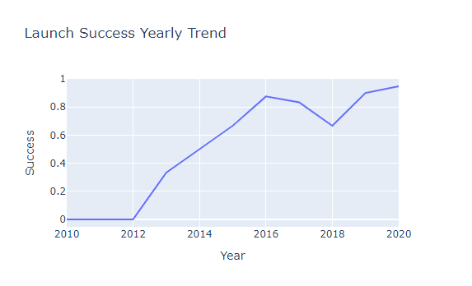
Launch Success Yearly Trend
Objective: Show the trend of launch success over the years.
Explanation
This line chart shows the trend of launch success rates over the years

Slide 30
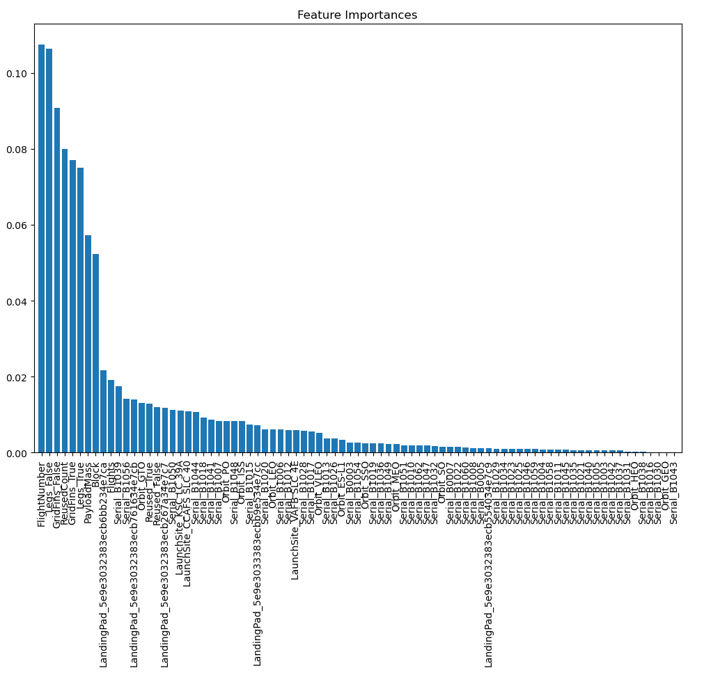
Feature Importances

Slide 31
All Launch Site Names
Display the names of the unique launch sites in the space mission
%sql SELECT DISTINCT Launch_Site FROM SPACEXTABLE;
Launch_Site
CCAFS LC-40
VAFB SLC-4E
KSC LC-39A
CCAFS SLC-40
df['LaunchSite'].unique() retrieves a list of all unique launch site names. This helps in identifying all the distinct launch sites in the dataset.
All Launch Site Names:
['CCSFS SLC 40' 'VAFB SLC 4E' 'KSC LC 39A']

Slide 32
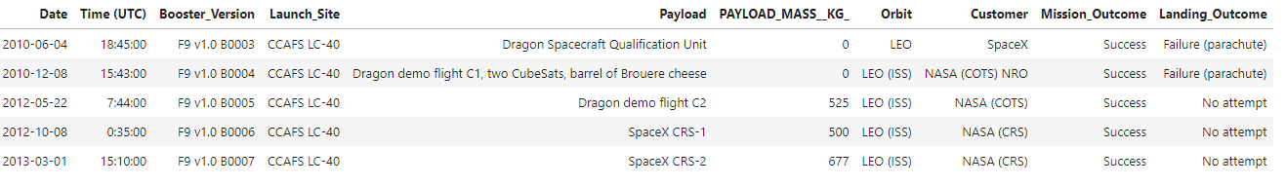
Launch Site Names Begin with 'CCA'
Display 5 records where launch sites begin with the string 'CCA'
%sql SELECT * FROM SPACEXTABLE WHERE Launch_Site LIKE 'CCA%' LIMIT 5;

Slide 33
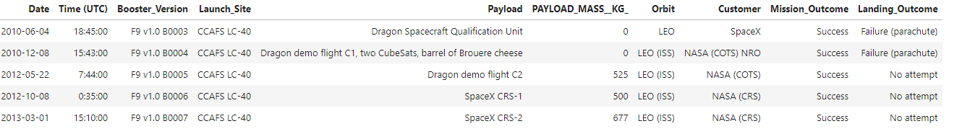
Total Payload Mass
Display the total payload mass carried by boosters launched by NASA (CRS)
Display the total payload mass carried by boosters launched by NASA (CRS)
%%sql SELECT SUM(PAYLOAD_MASS__KG_) AS TotalPayloadMass
FROM SPACEXTABLE
WHERE Customer = 'NASA (CRS)' AND PAYLOAD_MASS__KG_ IS NOT NULL;
AvgPayloadMass
2928.4

Slide 34
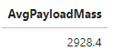
Average Payload Mass by F9 v1.1
Display average payload mass carried by booster version F9 v1.1
%%sql SELECT AVG(PAYLOAD_MASS__KG_) AS AvgPayloadMass
FROM SPACEXTABLE
WHERE Booster_Version = 'F9 v1.1' AND PAYLOAD_MASS__KG_ IS NOT NULL;

Slide 35
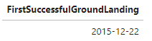
First Successful Ground Landing Date
List of date when the first successful landing outcome in ground pad was achieved.
%%sql SELECT MIN(Date) AS FirstSuccessfulGroundLanding
FROM SPACEXTABLE
WHERE Landing_Outcome LIKE 'Success (ground pad)';

Slide 36
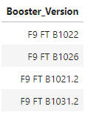
Successful Drone Ship Landing with Payload between 4000 and 6000
List of names of the boosters which have success in drone ship and have payload mass greater than 4000 but less than 6000
%%sql SELECT DISTINCT Booster_Version
FROM SPACEXTABLE
WHERE Landing_Outcome LIKE 'Success (drone ship)' AND PAYLOAD_MASS__KG_ BETWEEN 4000 AND 6000;

Slide 37
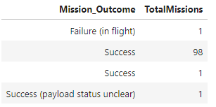
Total Number of Successful and Failure Mission Outcomes
List of Total Number of Successful and Failure Mission Outcome
%%sql SELECT Mission_Outcome, COUNT(*) AS TotalMissions
FROM SPACEXTABLE
GROUP BY Mission_Outcome;

Slide 38
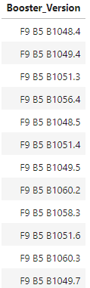
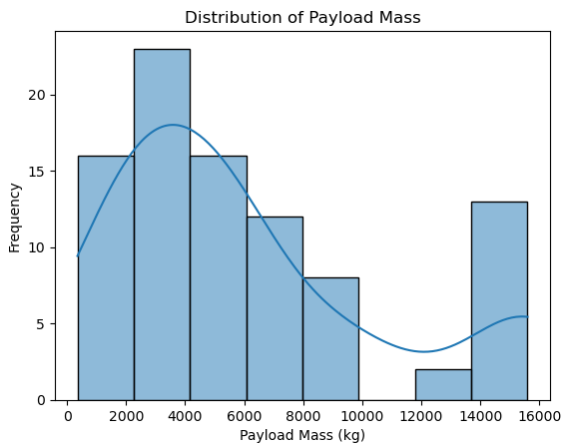
Boosters Carried Maximum Payload
List the Names of the Booster Versions Which Have Carried the Maximum Payload Mass
%%sql SELECT Booster_Version
FROM SPACEXTABLE
WHERE PAYLOAD_MASS__KG_ = (SELECT MAX(PAYLOAD_MASS__KG_) FROM SPACEXTABLE);

Slide 39
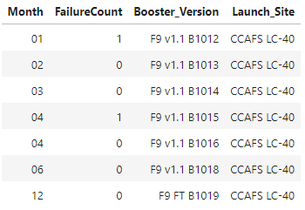
2015 Launch Records
List of Records Displaying Month Names, Failure Landing Outcomes in Drone Ship, Booster Versions, and Launch Site for the Months in 2015
%%sql SELECT strftime('%m', Date) AS Month,
COUNT(CASE WHEN Landing_Outcome LIKE 'Failure (drone ship)' THEN 1 END) AS FailureCount,
Booster_Version,
Launch_Site
FROM SPACEXTABLE
WHERE strftime('%Y', Date) = '2015'
GROUP BY Month, Booster_Version, Launch_Site;

Slide 40
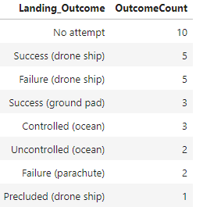
Rank Landing Outcomes Between 2010-06-04 and 2017-03-20
Rank the Count of Landing Outcomes (Such as Failure (drone ship) or Success (ground pad)) Between the Dates 2010-06-04 and 2017-03-20
%%sql SELECT Landing_Outcome, COUNT(*) AS OutcomeCount
FROM SPACEXTABLE
WHERE Date BETWEEN '2010-06-04' AND '2017-03-20'
GROUP BY Landing_Outcome
ORDER BY OutcomeCount DESC;

Slide 41

Section 3

Slide 42
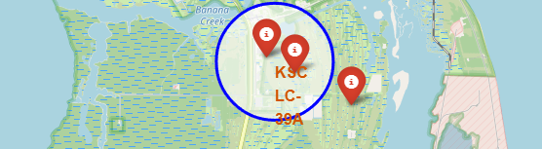
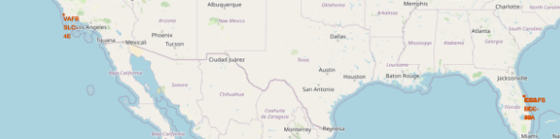
Mark all launch sites on the map
Explanation:
Initialize the Map:
The map is centered around NASA Johnson Space
Center with a zoom level of 5 to get a global view.
Loop Through Each Launch Site:
For each launch site in the dataset:
Circle: A folium.Circle is added to represent the site.
The radius parameter defines how large the circle should be.
Marker: A folium.Marker is added with a popup showing
the name of the launch site. The DivIcon is used to customize
the appearance of the marker text.
Save the Map:
The map is saved as an HTML file that you can open in a web
browser to view the interactive map.

Slide 43
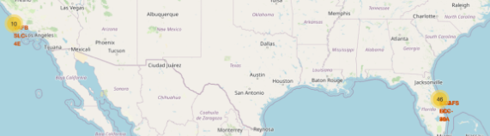
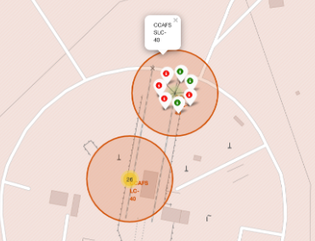
Mark the success/failed launches
Visualize the outcomes of SpaceX launches by marking the launch sites on a map and using color-coded circles to differentiate between successful and failed launches. This helps in understanding the geographical distribution of launch outcomes.

Slide 44
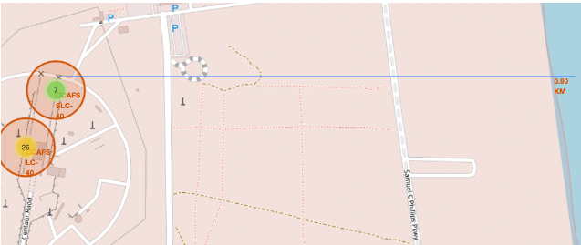
Distances between a launch site ti its proximities
Visualize the selected launch site's proximity to nearby geographical features such as railways, highways, and coastlines. The goal is to provide a detailed view of the launch site’s surroundings and calculate distances to these features.

Slide 45

Section 4

Slide 46
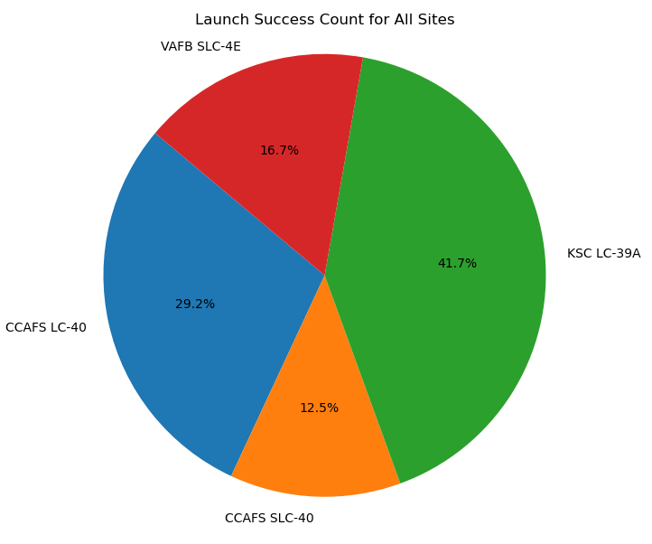
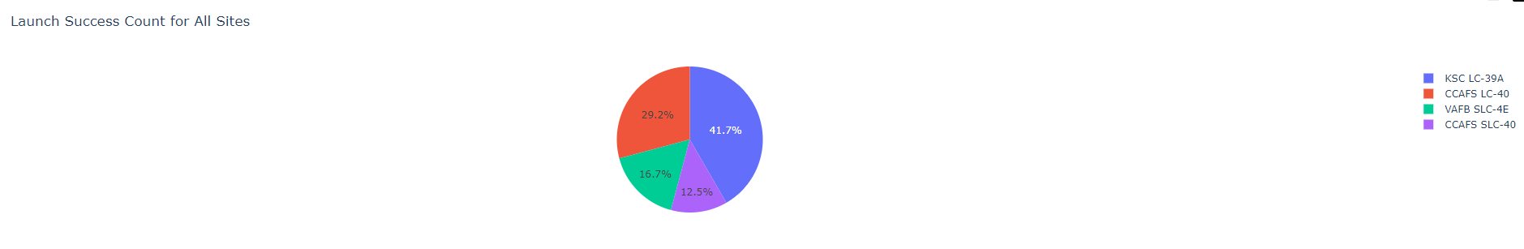
Pie Chart Showing the Launch Success Count for All Sites
To generate a pie chart showing the launch success count for all sites, follow these steps:
Load the Data: Ensure your data is loaded into a Pandas DataFrame.
Aggregate the Data: Count the number of successful launches for each site.
Plot the Pie Chart: Use Matplotlib or Plotly to create the pie chart.
The Second Pie Chart drawn by plotly

Slide 47
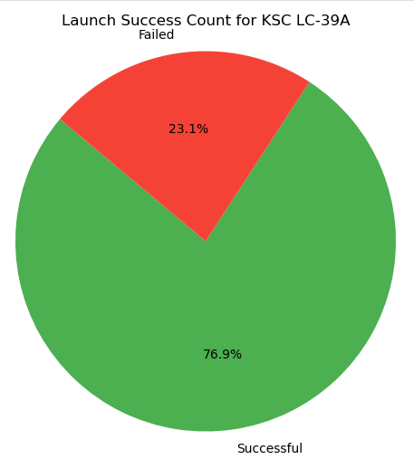
Launch Site with Highest Launch Success Ratio

Slide 48
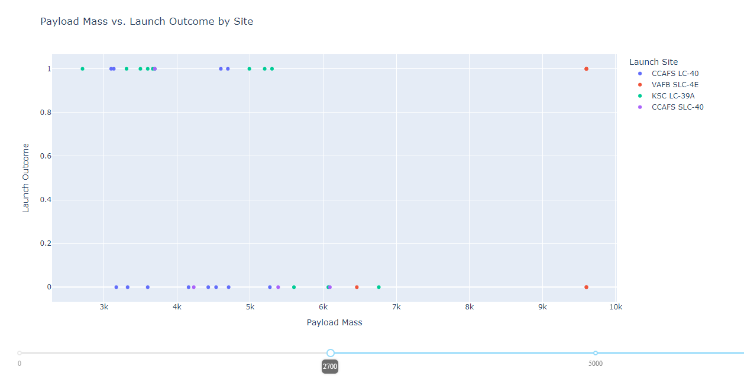
Payload Mass vs Launch Outcome by Size

Slide 49

Section 5

Slide 50
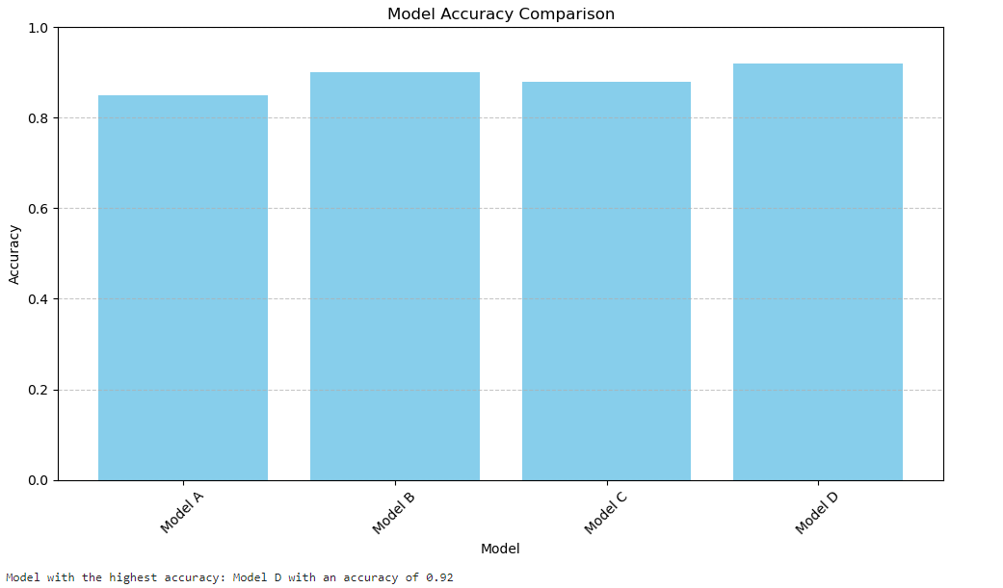
Classification Accuracy
Summary
The bar chart will help you visualize and compare the performance of different classification models, while the output of the script will tell you which model achieved the highest classification accuracy.

Slide 51
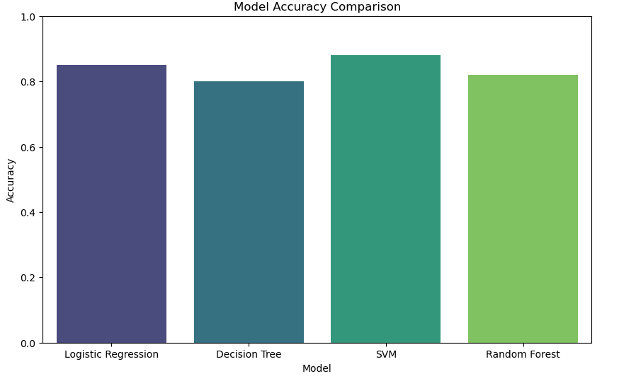
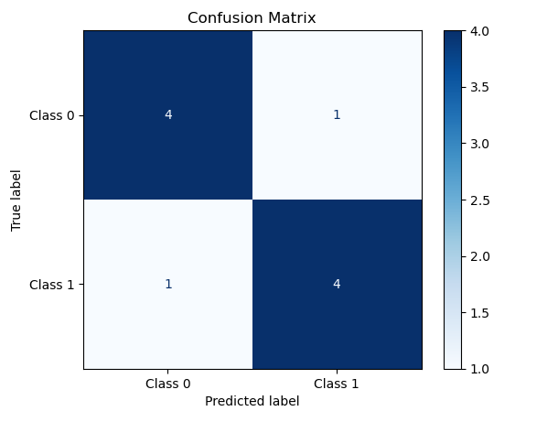
Confusion Matrix

Slide 52
Confusion Matrix - Explanation
Explanation:
Confusion Matrix: This matrix is a summary of prediction results on a classification problem. It compares the predicted labels to the true labels and is used to evaluate the performance of a classification model.
Matrix Layout:
True Positives (TP): The number of correct predictions that an instance is positive.
True Negatives (TN): The number of correct predictions that an instance is negative.
False Positives (FP): The number of incorrect predictions that an instance is positive.
False Negatives (FN): The number of incorrect predictions that an instance is negative.
Matrix Interpretation:
The diagonal values (TP and TN) show correct classifications.
The off-diagonal values (FP and FN) indicate misclassifications.
Metrics Derived from Confusion Matrix:
Accuracy: TP+TNTP+TN+FP+FN\frac{TP + TN}{TP + TN + FP + FN}TP+TN+FP+FNTP+TN​
Precision: TPTP+FP\frac{TP}{TP + FP}TP+FPTP​
Recall: TPTP+FN\frac{TP}{TP + FN}TP+FNTP​
F1 Score: 2×Precision×RecallPrecision+Recall2 \times \frac{\text{Precision} \times \text{Recall}}{\text{Precision} + \text{Recall}}2×Precision+RecallPrecision×Recall​
Summary
The confusion matrix provides detailed insights into the performance of your best model. It allows you to see not only the number of correct and incorrect predictions but also how those predictions are distributed among the different classes. This helps in understanding the model's behavior, especially in cases where there might be class imbalances or specific types of errors that need to be addressed.

Slide 53
Conclusions
In this SpaceX Capstone Project, we undertook a comprehensive analysis to understand and predict the success of SpaceX launches. The project was structured into several key phases, each contributing to the overall goal of building a predictive model and visualizing the results effectively.
1. Exploratory Data Analysis (EDA)
Data cleaning and Preparation
Visualisation
Correlation Analysis
2. Predictive Modelling
Model Building
Hyperparameter Tuning
Model Evaluation
3. Model Visualisation
Accuracy Comparison
Confusion Matrix
4. Interactive Dashboards
Launch Site Maps
Payload vs Launch Outcome
5. SQL Analysis
Unique Launch Sites
Successful Landings
Launch Statistics
6. Final Insights
Launch Success Factors
Model Effectiveness
Visual Analytics

Slide 54
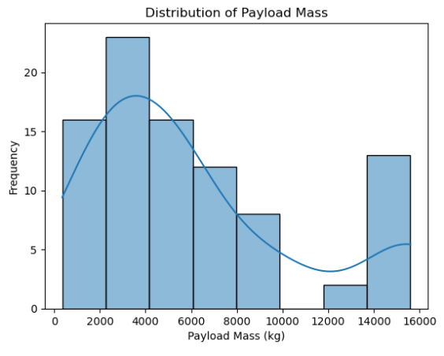
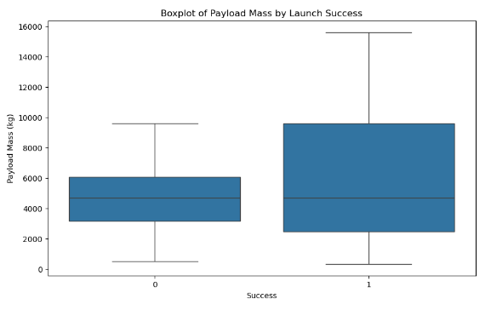
Appendix-A
Univariate Analysis (code snippet)
Histogram of PayloadMass:
import seaborn as sns
import matplotlib.pyplot as plt
import pandas as pd
df=pd.read_csv('./dataset_part_1.csv')
sns.histplot(df['PayloadMass'], kde=True)
plt.title('Distribution of Payload Mass')
plt.xlabel('Payload Mass (kg)')
plt.ylabel('Frequency')
plt.show()
df['Success'] = df['Outcome'].apply(lambda x: 1 if 'None' not in x else 0)
plt.figure(figsize=(10, 6))
sns.boxplot(x='Success', y='PayloadMass', data=df)
plt.xlabel('Success') plt.ylabel('Payload Mass (kg)')
plt.title('Boxplot of Payload Mass by Launch Success')
plt.show()
spacex-data-collection jupyter note book on github:
URL: https://github.com/sandorvas/applied-data-science-capstone/blob/main/jupyter-labs-spacex-data-collection-api.ipynb

Slide 55
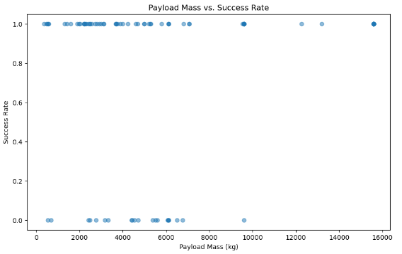
Appendix-A
Bivariate Analysis (code snippets)
plt.figure(figsize=(10, 6))
plt.scatter(df['PayloadMass'], df['Success'], alpha=0.5)
plt.title('Payload Mass vs. Success Rate')
plt.xlabel('Payload Mass (kg)')
plt.ylabel('Success Rate')
plt.show()
spacex-data-collection jupyter note book on github:
URL: https://github.com/sandorvas/applied-data-science-capstone/blob/main/jupyter-labs-spacex-data-collection-api.ipynb

Slide 56
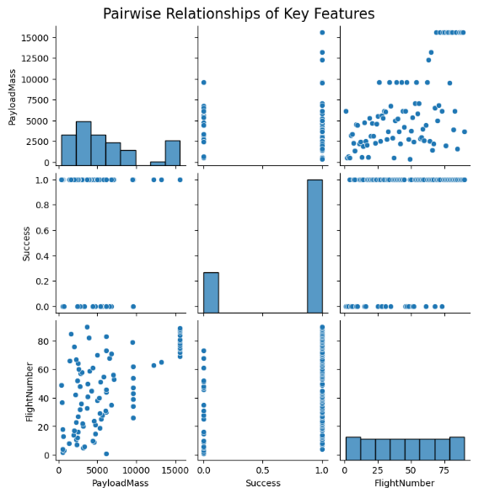
Appendix-A (continue)
Bivariate Analysis (code snippets)
Pair Plot of Key Features
Purpose: To visualize pairwise relationships between several key features.
Insight: Understand correlations between features like payload mass,
flight number, and mission duration.
Code Snippet
plt.figure(figsize=(10, 8))
pair_plot = sns.pairplot(df[['PayloadMass', 'Success', 'FlightNumber']])
plt.suptitle('Pairwise Relationships of Key Features', y=1.02, fontsize=16)
plt.show()
spacex-data-collection jupyter note book on github:
URL: https://github.com/sandorvas/applied-data-science-capstone/blob/main/jupyter-labs-spacex-data-collection-api.ipynb

Slide 57
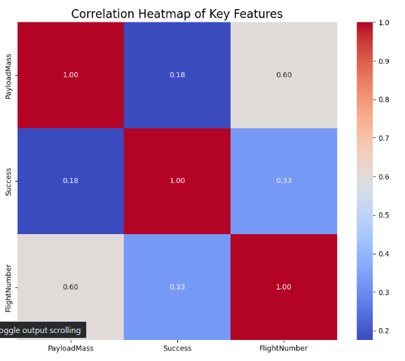
Appendix-A (continue)
Multivariate Analysis (code snippets)
Heatmap of Correlations:
# Drop non-numeric columns
numeric_df = df[['PayloadMass', 'Success', 'FlightNumber']].copy()
# Calculate correlation matrix
corr_matrix = numeric_df.corr()
# Create the heatmap
plt.figure(figsize=(10, 8))
sns.heatmap(corr_matrix, annot=True, cmap='coolwarm', fmt='.2f')
# Adjust the title
plt.title('Correlation Heatmap of Key Features', fontsize=16)
# Display the heatmap
plt.show()
spacex-data-collection jupyter note book on github:
URL: https://github.com/sandorvas/applied-data-science-capstone/blob/main/jupyter-labs-spacex-data-collection-api.ipynb

Slide 58
Appendix-A (continue)
spacex-data-collection jupyter note book on github:
URL: https://github.com/sandorvas/applied-data-science-capstone/blob/main/jupyter-labs-spacex-data-collection-api.ipynb

Slide 59
Appendix-A github url
https://github.com/sandorvas/applied-data-science-capstone

Slide 60


